Slide 1

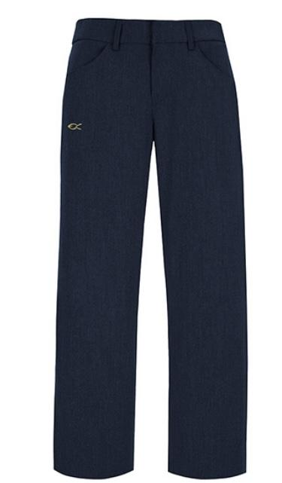
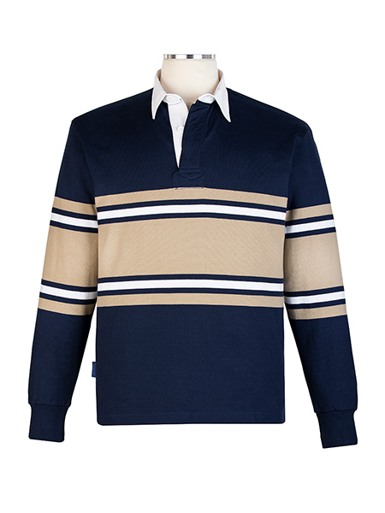


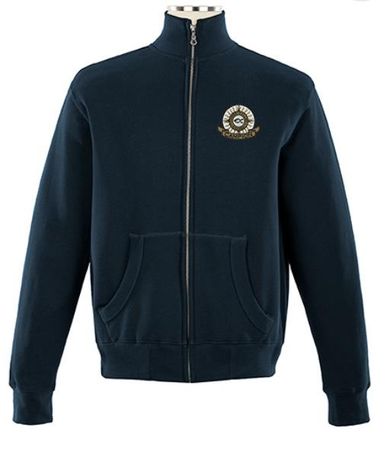
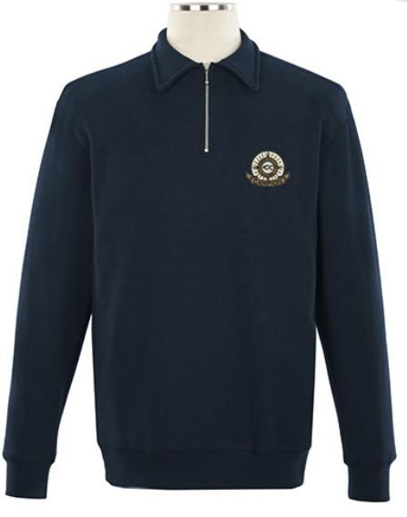
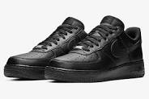
MANDATORY UNIFORM ITEMS
OPTIONAL PIECES
AND
OR
Notes:
Add uniform here

Slide 2
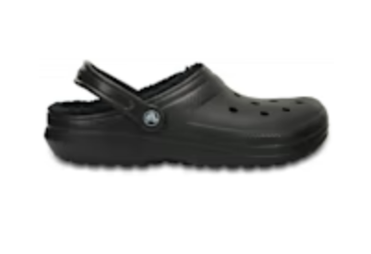
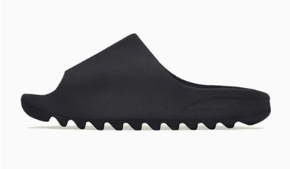
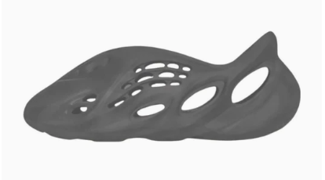
MUST BE AN ALL-BLACK SHOE
✅
🆇
NO SLIDES, CROCS, OR FOAM RUNNERS.
Notes:
Add uniform here

